Slide 1
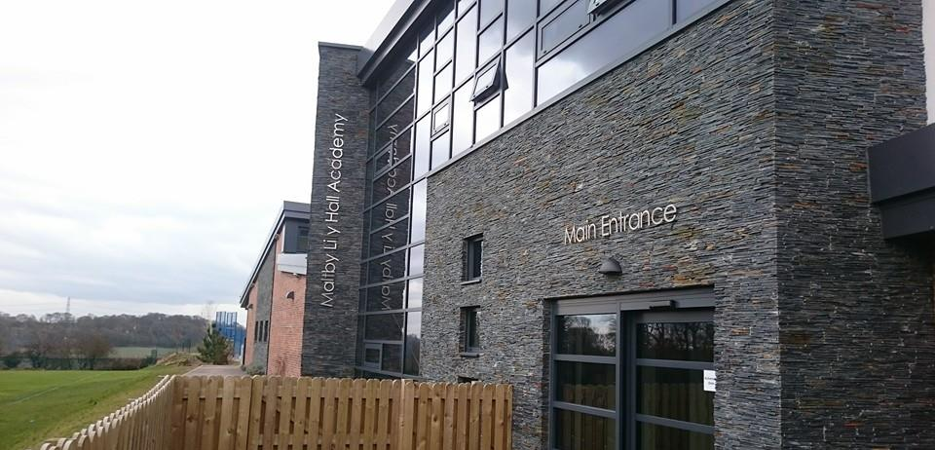
EYFS Foundation Stage
At Maltby Lilly Hall Academy

Slide 2
Daily Routine
Timetable
Welcome, register, calendar, timetable
Morning task - including reading/keyrings
Phonics: Read Write Inc
Maths/Physical
Snack
English
Song and rhyme
Dinner
Revisit keywords/number
PE/curriculum areas/provision areas
Input
Continue learning in areas/individual readers
Story
Home time
School starts at 8.45am
Dinnertime is 11.30 – 12.30pm
School finishes at 3.15pm
Children will organise their own belongings independently – locate their hook, hang up their PE kit and coat and put their bag (if needed) on the bench.
Children will enter class, put their water bottle (clearly labelled) on the table and find their correct coloured box for their book bag.
They will then sit at their table.
Nature explorers – every fortnight (they will need a pair of wellies which will remain in school).
PE – twice a week

Slide 3
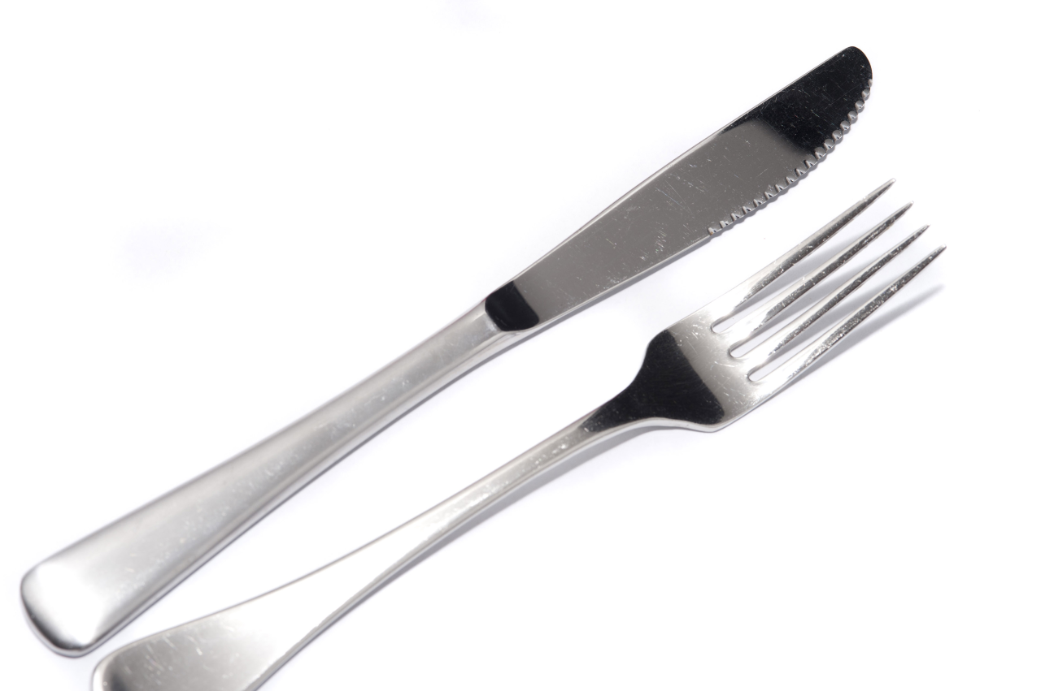
Independence
Getting dressed independently every day
Practise fastening buttons, putting on socks and their shoes on the right feet.
Putting their coat on and zipping it up.
Turning clothes the correct way round.
Accessing the toilet independently – being able to care for their own personal hygiene.
Cutting food using a real knife and fork.
Tidying up their toys and giving them small, simple responsibilities, such as emptying the washing machine.
Please make sure your child's name is in all their belongings.

Slide 4
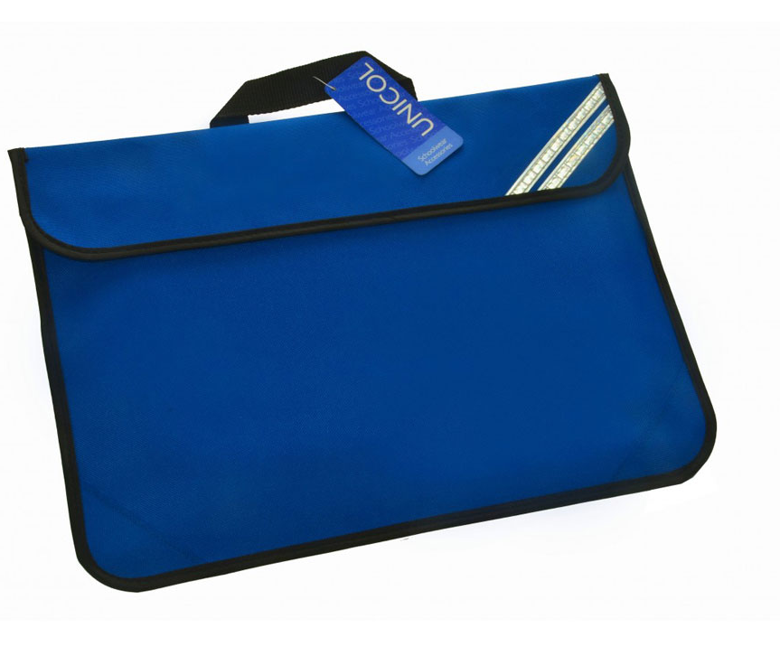
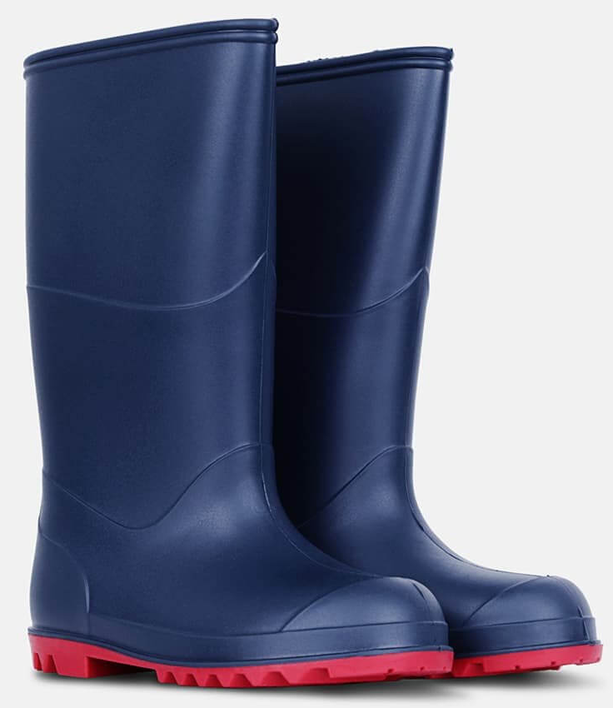
What your child needs for school
School uniform – clearly labelled
Water bottle (water only) labelled with their name
Coat/jacket
Sun hat/suncream (weather permitting) – clearly labelled
School book bag (flat bag that will go in their table box)
PE kits – black shorts and white t-shirt.
All jewellery must be removed before coming to school on PE days and hair tied up.
Wellies – clearly labelled and will remain in school for the year

Slide 5
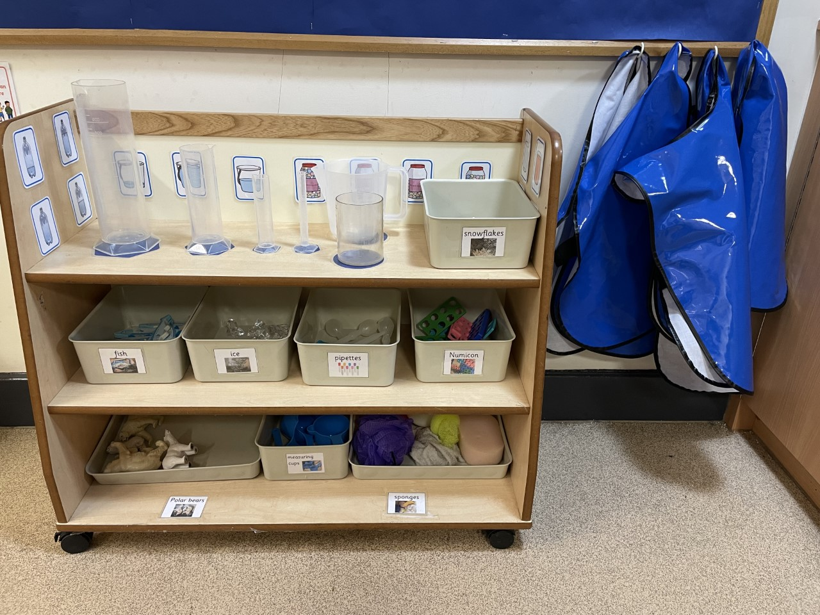
Areas of provision
Accessed during the day (child initiated)
Clear learning intentions
Labelled and organised
Purposeful
High quality resources
Clear, high expectations. How many children in each area?
Tidy up time – this is a TEAM approach
Experiences and areas that meet the needs of all.

Slide 6
‘Good to be green’
Every child starts the day on green
Clear expectations and rules for all
Children will have a verbal warning and if they continue, they will receive a yellow card
If the child persists after another verbal warning about the same behaviour, they will then be on a red card. Children can earn these back!
Any red cards given must be reported to parents at the end of the day with an explanation.
Children who have been ‘green’ all day will receive a sticker at the end of the day.
Children will say ‘Please don’t do that’ and put their hand up to signal that they do not like what someone is doing. It also signals that is their personal space.

Slide 7
Core characteristics of learning
Beads will be given throughout the day and everyone stopped to celebrate achievements – building the TEAM up
Class lists on display to identify children’s CLC achievements when seen consistently – 3 spots gets a certificate
These are celebrated alongside their peers and the reasons given
Linked to special mentions assembly every Friday. Children’s photos will remain on display for the week to celebrate their special mention.

Slide 8
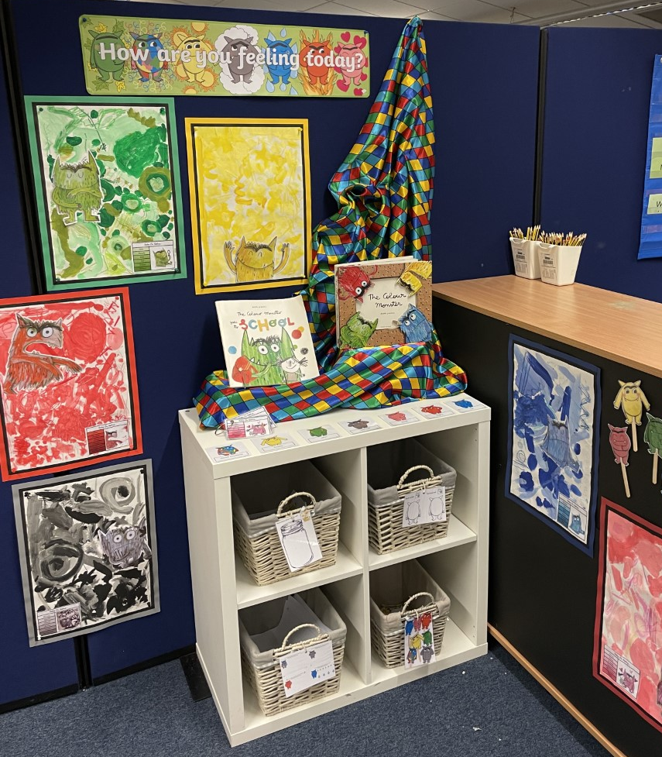
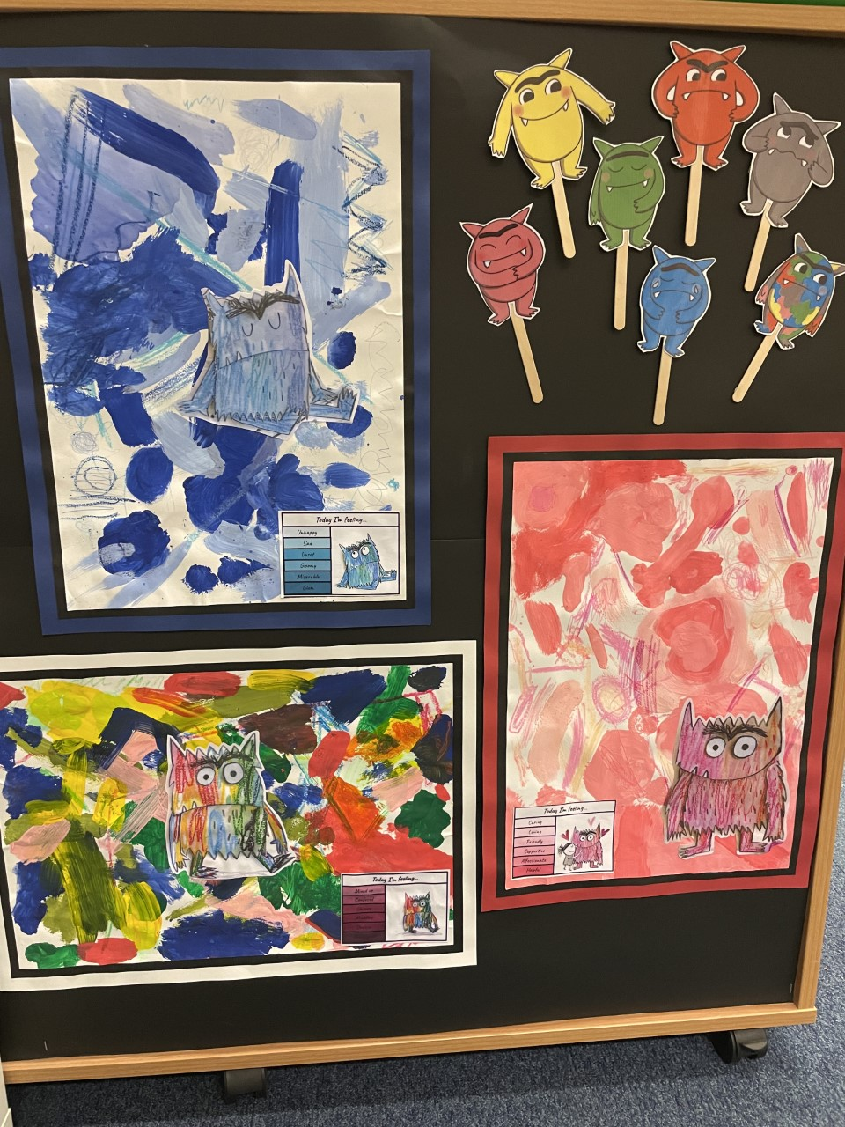
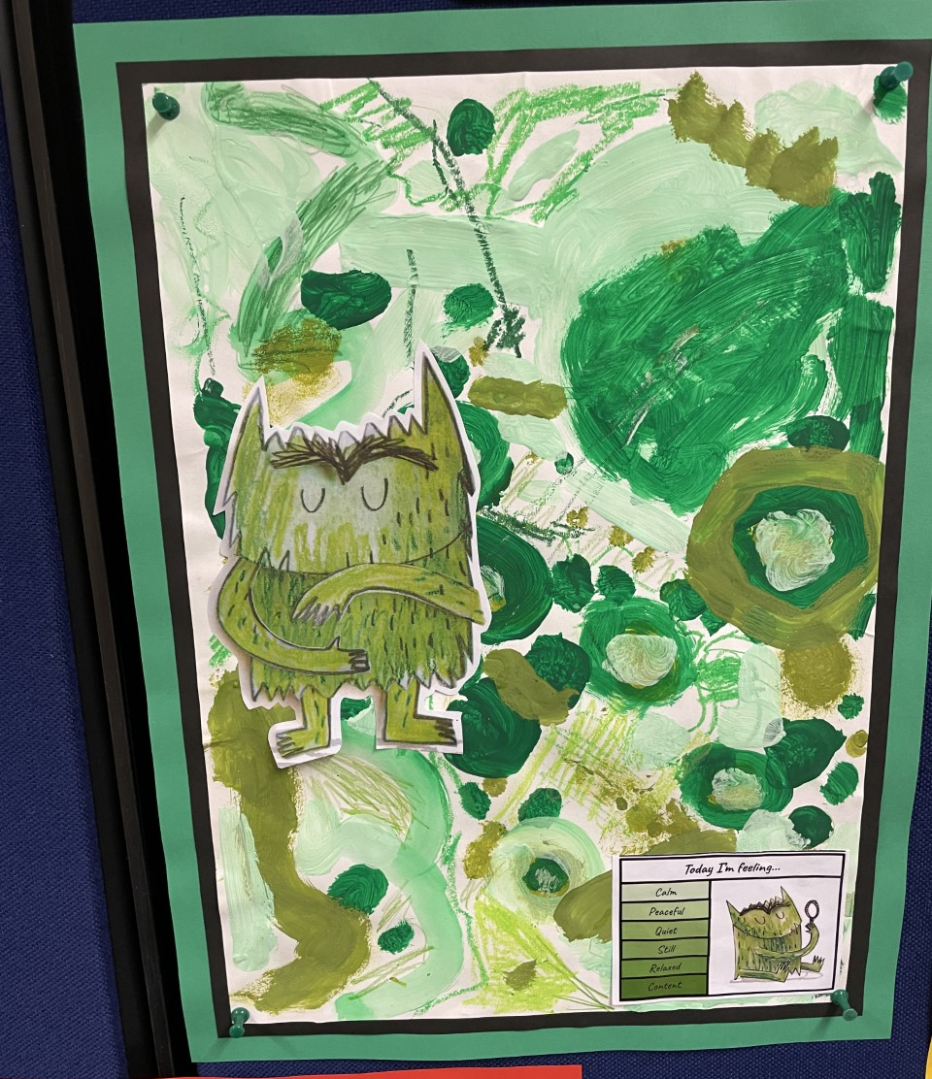
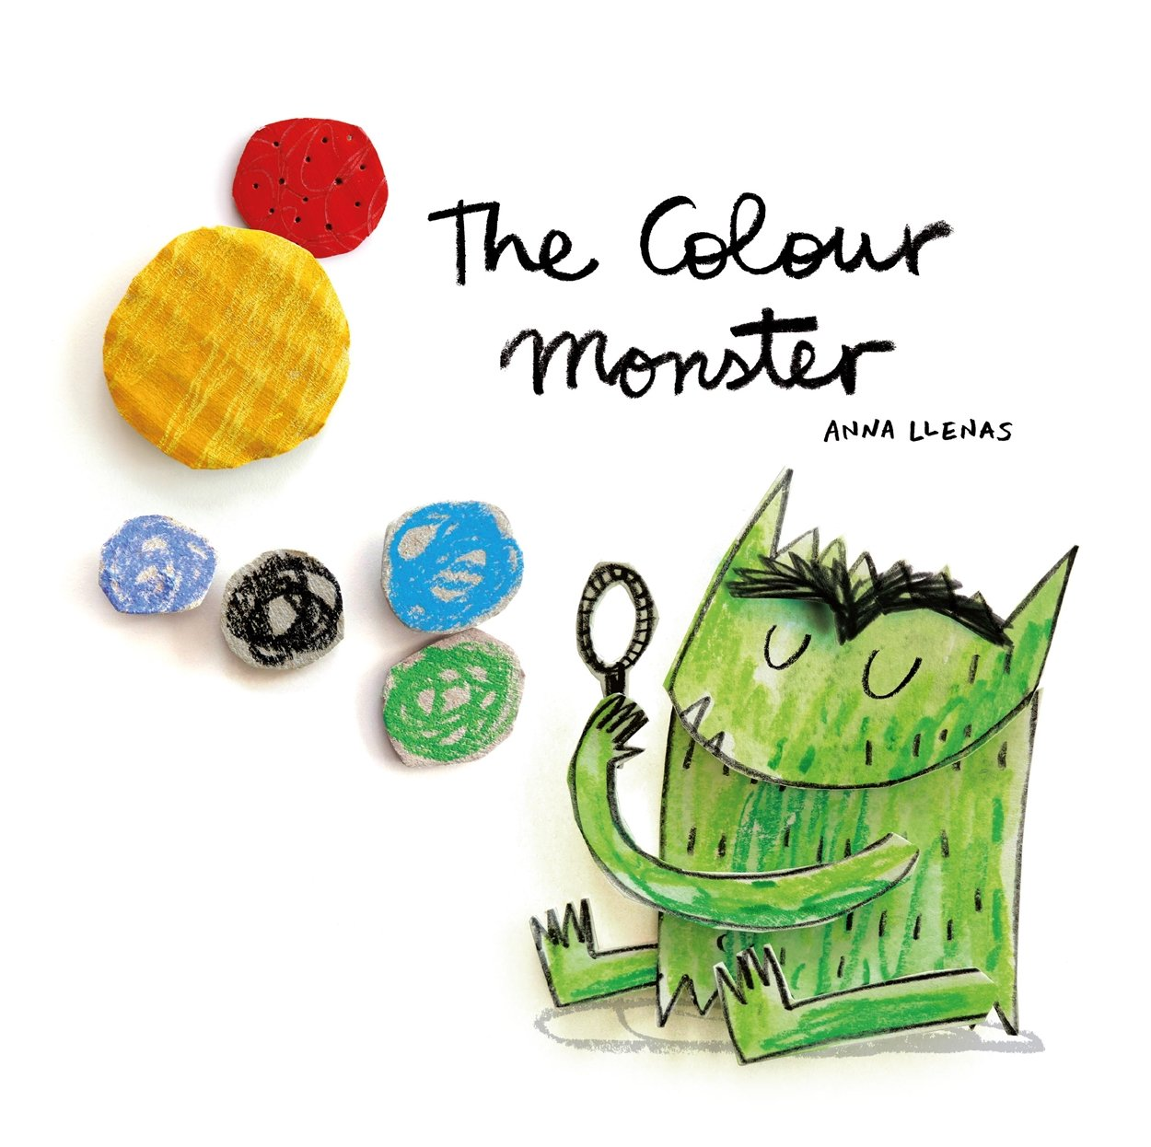
Colour Monster
To support children to understand their emotions.
Visual – children can relate.
Adult to ask/help children to identify their feelings using the colour monsters throughout the day.
I imagine…. I wonder if…. Are phrases used to allow children to identify their feelings.
Children who are finding it difficult to control/identify their emotions will use the puppets, find the relevant page in the text, pencil control sheet, colour in the monsters using the correct colour or even draw the colour monster using the correct colour. They will also use the specific area within the class.
Those children finding it difficult to regulate/engage with adults. We will spend time with the children, they will feel listened to.
Adults to help children identify what has led to their dysregulation.

Slide 9
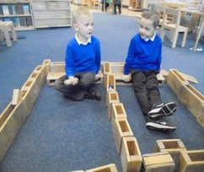
Prime areas of learning
Communication and language
Physical development
Personal, social and emotional
Listening, Attention and Understanding ELG
• Listen attentively and respond to what they hear with relevant questions, comments and actions when being read to and during whole class discussions and small group interactions;
• Make comments about what they have heard and ask questions to clarify their understanding;
• Hold conversation when engaged in back-and-forth exchanges with their teacher and peers.
Speaking ELG
• Participate in small group, class and one-to-one discussions, offering their own ideas, using recently introduced vocabulary;
• Offer explanations for why things might happen, making use of recently introduced vocabulary from stories, non-fiction, rhymes and poems when appropriate;
• Express their ideas and feelings about their experiences using full sentences, including use of past, present, and future tenses and making use of conjunctions, with modelling and support from their teacher.
Personal, Social and Emotional Development Self-Regulation ELG
• Show an understanding of their own feelings and those of others, and begin to regulate their behaviour accordingly;
• Set and work towards simple goals, being able to wait for what they want and control their immediate impulses when appropriate;
• Give focused attention to what the teacher says, responding appropriately even when engaged in activity, and show an ability to follow instructions involving several ideas or actions.
Managing Self ELG
• Be confident to try new activities and show independence, resilience and perseverance in the face of challenge;
• Explain the reasons for rules, know right from wrong and try to behave accordingly;
• Manage their own basic hygiene and personal needs, including dressing, going to the toilet, and understanding the importance of healthy food choices. 20
Building Relationships ELG
• Work and play cooperatively and take turns with others;
• Form positive attachments to adults and friendships with peers;
• Show sensitivity to their own and to others’ needs.

Slide 10
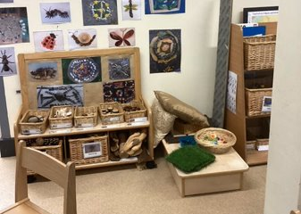
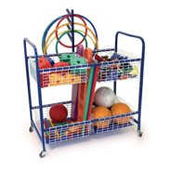
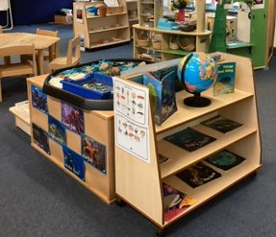
Prime areas continued
Early years foundation stage profile handbook_2023 (publishing.service.gov.uk)
Physical Development Gross Motor Skills ELG
• Negotiate space and obstacles safely, with consideration for themselves and others;
• Demonstrate strength, balance and coordination when playing;
• Move energetically, such as running, jumping, dancing, hopping, skipping and climbing.
Fine Motor Skills ELG
• Hold a pencil effectively in preparation for fluent writing – using the tripod grip in almost all cases;
• Use a range of small tools, including scissors, paint brushes and cutlery;
• Begin to show accuracy and care when drawing.

Slide 11
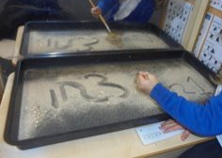
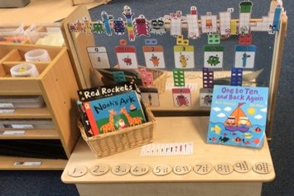
Specific areas
Early years foundation stage profile handbook_2023 (publishing.service.gov.uk)
Comprehension ELG
• Demonstrate understanding of what has been read to them by retelling stories and narratives using their own words and recently introduced vocabulary;
• Anticipate – where appropriate – key events in stories;
• Use and understand recently introduced vocabulary during discussions about stories, non-fiction, rhymes and poems and during role-play.
Word Reading ELG
• Say a sound for each letter in the alphabet and at least 10 digraphs;
• Read words consistent with their phonic knowledge by sound-blending;
• Read aloud simple sentences and books that are consistent with their phonic knowledge, including some common exception words.
Writing ELG
• Write recognisable letters, most of which are correctly formed;
• Spell words by identifying sounds in them and representing the sounds with a letter or letters;
• Write simple phrases and sentences that can be ready by others.
Mathematics
Number ELG
• Have a deep understanding of number to 10, including the composition of each number;
• Subitise (recognise quantities without counting) up to 5;
• Automatically recall (without reference to rhymes, counting or other aids) number bonds up to 5 (including subtraction facts) and some number bonds to 10, including double facts.
Numerical Patterns ELG
• Verbally count beyond 20, recognising the pattern of the counting system;
• Compare quantities up to 10 in different contexts, recognising when one quantity is greater than, less than or the same as the other quantity;
• Explore and represent patterns within numbers up to 10, including evens and odds, double facts and how quantities can be distributed equally.

Slide 12
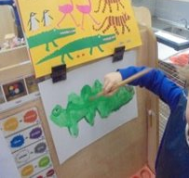
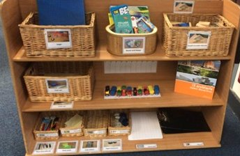
Specific areas continued
Understanding the World
Past and Present ELG
• Talk about the lives of the people around them and their roles in society;
• Know some similarities and differences between things in the past and now, drawing on their experiences and what has been read in class;
• Understand the past through settings, characters and events encountered in books read in class and storytelling;
People Culture and Communities ELG
• Describe their immediate environment using knowledge from observation, discussion, stories, non-fiction texts, and maps;
• Know some similarities and differences between different religious and cultural communities in this country, drawing on their experiences and what has been read in class;
• Explain some similarities and differences between life in this country and life in other countries, drawing on knowledge from stories, non-fiction texts and – when appropriate – maps.
The Natural World ELG
• Explore the natural world around them, making observations and drawing pictures of animals and plants;
• Know some similarities and differences between the natural world around them and contrasting environments, drawing on their experiences and what has been read in class;
• Understand some important processes and changes in the natural world
around them, including the seasons and changing states of matter.
Expressive Arts and Design
Creating with Materials ELG
• Safely use and explore a variety of materials, tools and techniques,
experimenting with colour, design, texture, form, and function;
• Share their creations, explaining the process they have used;
• Make use of props and materials when role playing characters in narratives and stories.
Being Imaginative and Expressive ELG
• Invent, adapt and recount narratives and stories with peers and their teacher;
• Sing a range of well-known nursery rhymes and songs;
• Perform songs, rhymes, poems and stories with others, and – when appropriate try to move in time with music.

Slide 13
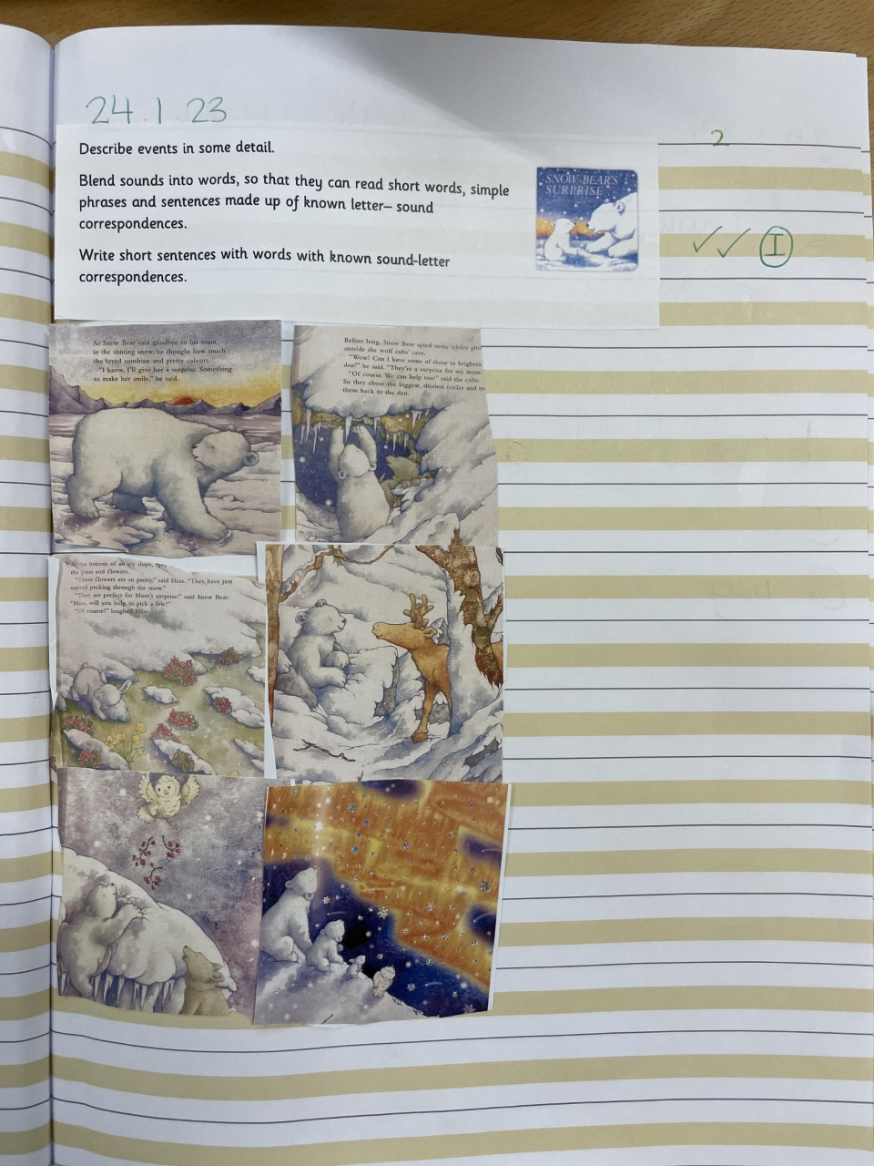
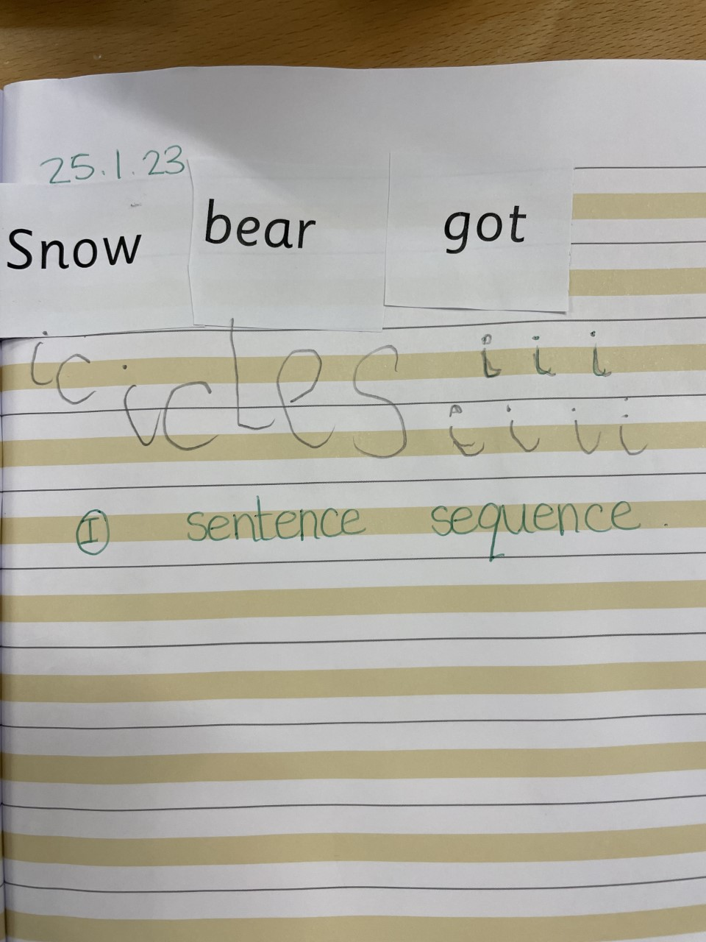
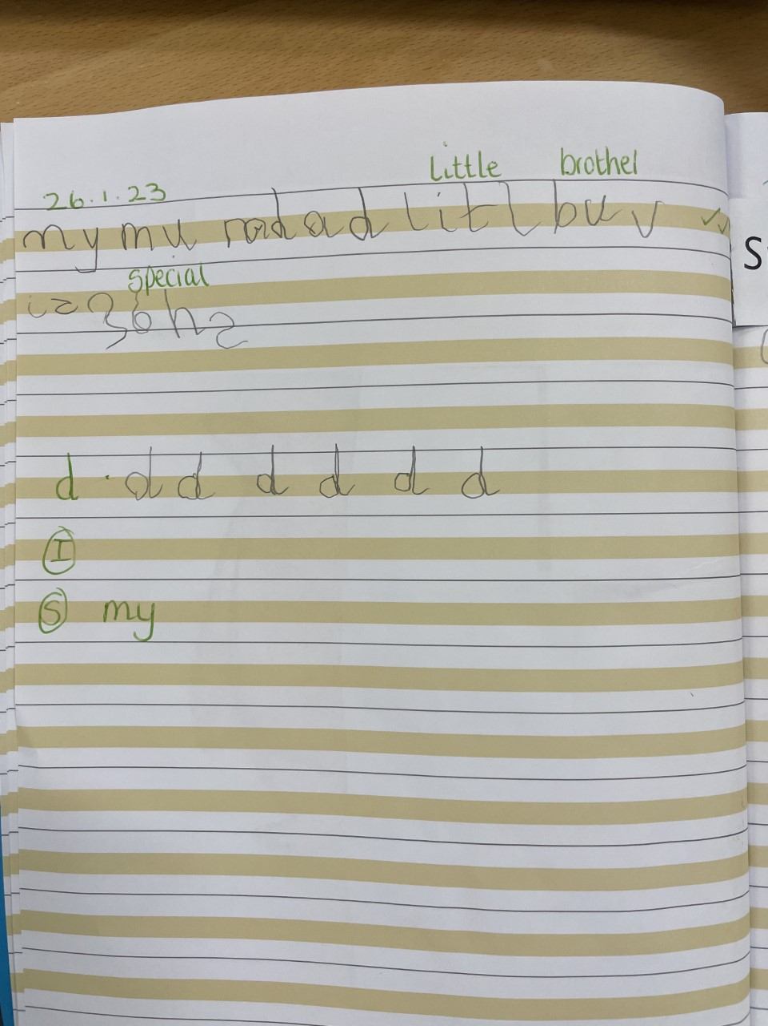
Work Books
High, clear expectations
3 tick marking system
1 tick - not yet achieved learning intention
2 ticks - achieved learning intention
3 ticks – surpassed learning intention
Handwriting - correct RWI formations. Incorrect letter formation will be corrected and practised.
Adults give incisive verbal feedback to improve.

Slide 14
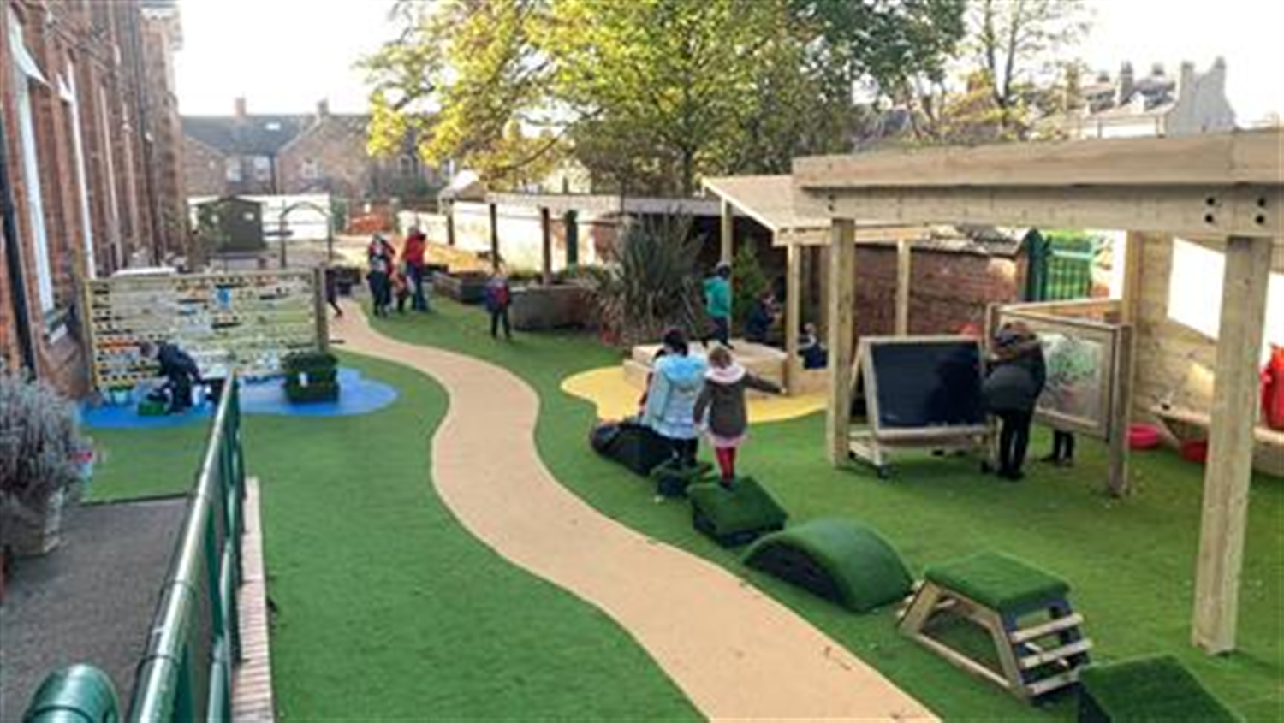
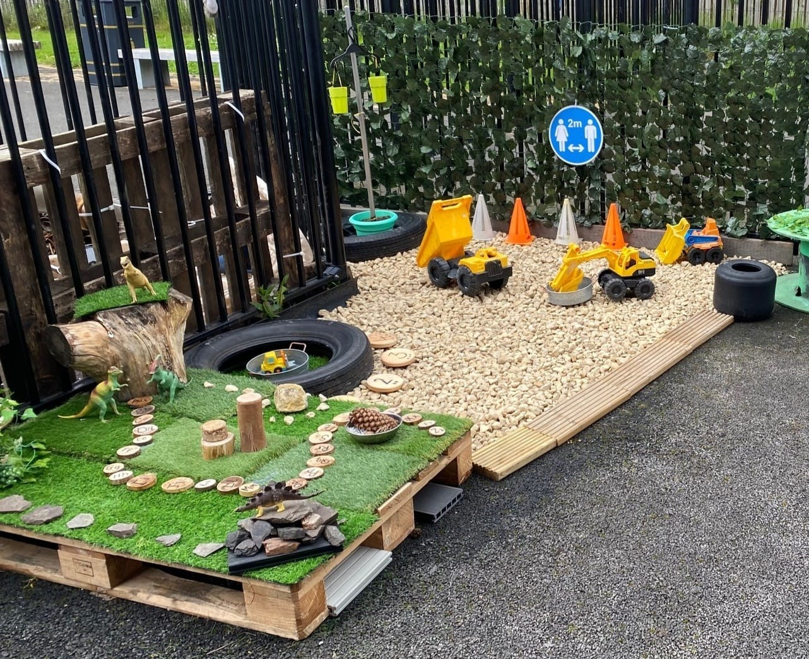
Outdoor provision next steps
Investigation corner (garden/senses)
Maths area
Gross Motor(skills/climbing/balancing)
Bikes (Scooters)
Small world
Outdoors will be an inspiring space
Exploration of problems
Experiment - test and find out
Active, transferrable skills
Gather information – listen to the children express their theories
Adults to tune into children's thinking and further learning
Adults to observe and question with curiosity, rather than judgement
Small construction
Large construction
Music area/performing area
Large writing area
Water exploration

Slide 15
Baking... Consent forms including a list of ingredients will be sent every time we bake. If you would like your child to bake, please ensure consent is given and returned to school. Thank you for your support!

